Slide 1
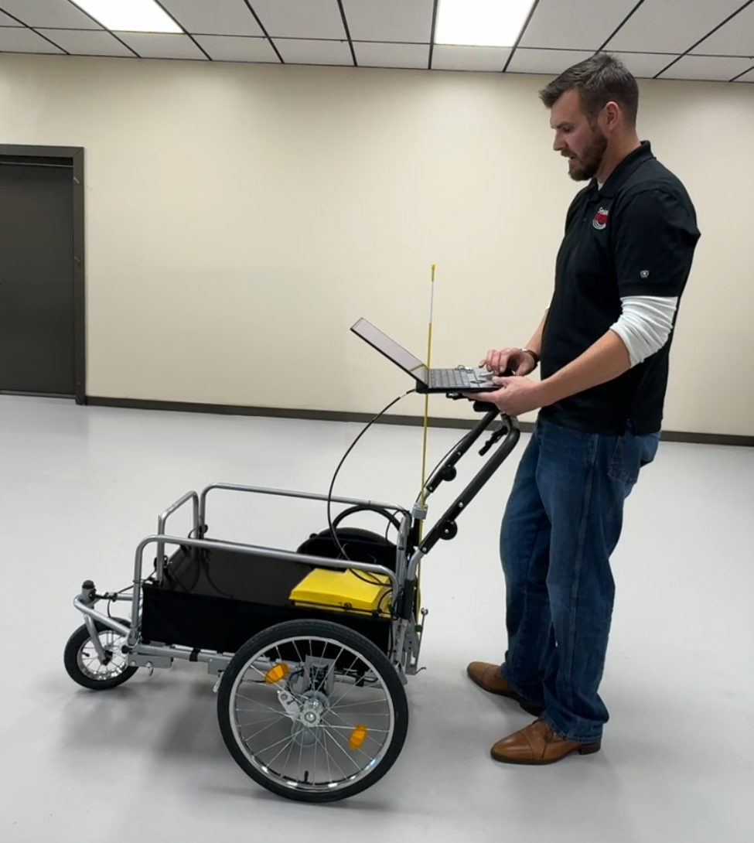
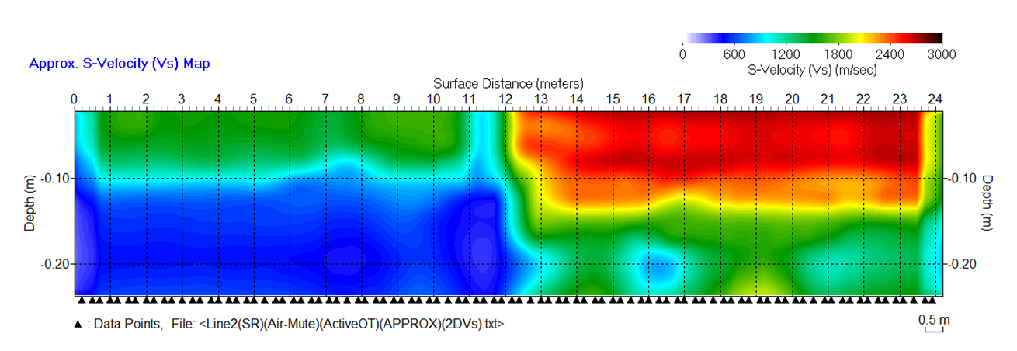
Concrete Evaluation Systems
SEE STIFFNESS. SEE STRUCTURE. SEE RESULTS.
Built for DOTs. Built for Engineers. Built for Field Deployment.
A breakthrough in pavement and concrete evaluation, SeisMike delivers rapid,
non-destructive stiffness mapping by combining controlled mechanical impact with air-coupled surface-wave sensing.
Why SeisMike?
Eliminate planted geophones and surface cabling
Avoid coring and destructible testing
Minimize traffic disruption and lane closures
Capture continuous, high-resolution data
Visualize stiffness in near real time
Scale from 24 to 48+ acquisition channels
Immediate Field Intelligence.
Within minutes, engineers can:
Quantify shear-wave velocity (Vs)
Determine pavement thickness
Identify elastic modulus contrasts
Detect structural transitions
Locate voids and stiffness anomalies
Make informed decisions before leaving the site.
Asphalt Road
Concrete Driveway
Example of SeisMike data acquired over a concrete driveway intersecting to a concrete driveway.
2026_03_04_SeisMike_Brochure.pptx 1/2

Slide 2
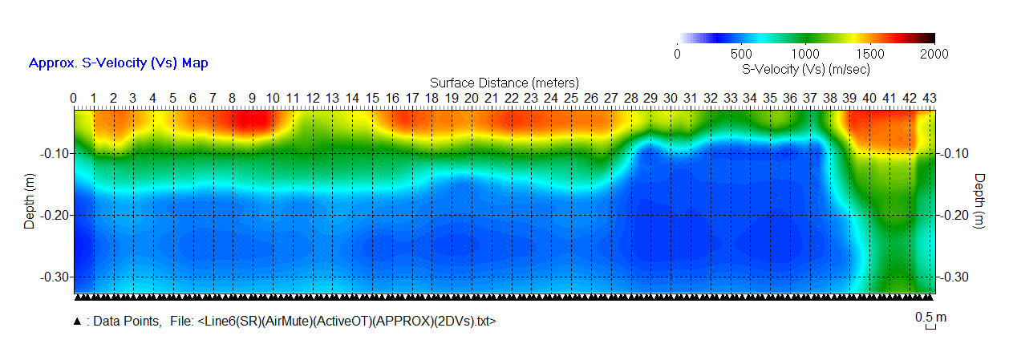
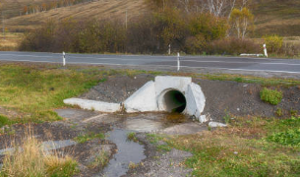
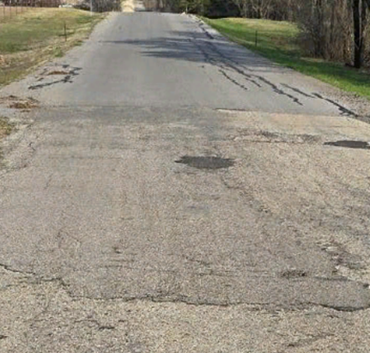
Asphalt and Concrete Evaluation Systems
SEE WHAT OTHERS MISS
Three Deployment Options:
SeisMike WallScan: Structural evaluation of walls, columns, and bridge piers
SeisMike CartScan: Indoor precision mapping with integrated positioning
SeisMike RoadScan: Vehicle-mounted roadway and runway evaluation
SeisMike Technology Features:
Acquisition: Compact MEMS microphone array
Seismograph: Multi-channel fast sampling 24-bit data acquisition
Source: Ultra-high frequency mechanical impact
Processing: Rapid surface-wave inversion
Outputs: Vs, Young’s modulus, shear modulus, density, and Poisson’s ratio
SeisMike System Features:
ParkSeis: PSX Real-Time MASW Software
Seismic Source: DAQlink Seismograph 5 or 6 with 24 to 96 channels or more
Olson Engineering: Ultra Fast Ping Source
Engineered for precision, scalability, and field efficiency
Tower Rd
County Rd
(Thicker Pavement)
Culvert
Patched Pavement Area
(Thinner Pavement)
Example of SeisMike data featuring a
cement culvert plus an asphalt road.
2026_03_04_SeisMike_Brochure.pptx 2/2

